Slide 1
Progress Update
2022. 11.15
송희수

Slide 2
Patient Sample (Positive)
PB417_01
S1_W1_Px1_Py1_C1
S1_W1_Px1_Py1_C2
S1_W1_Px1_Py1_C3
S1_W1_Px1_Py1_C4

Slide 3
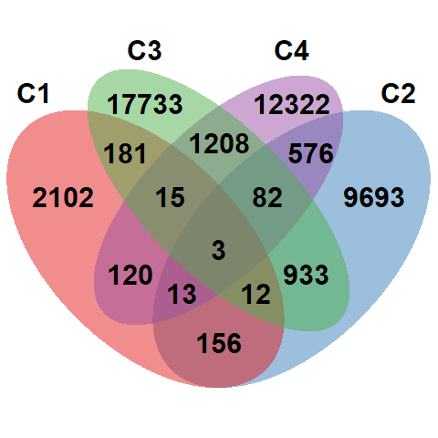
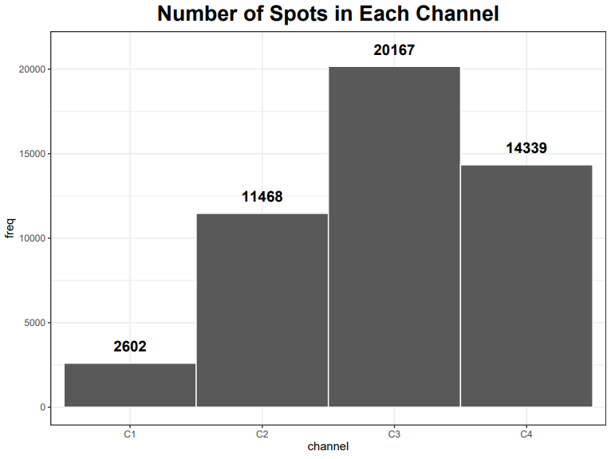
Explore Data - # spots per channel

Slide 4
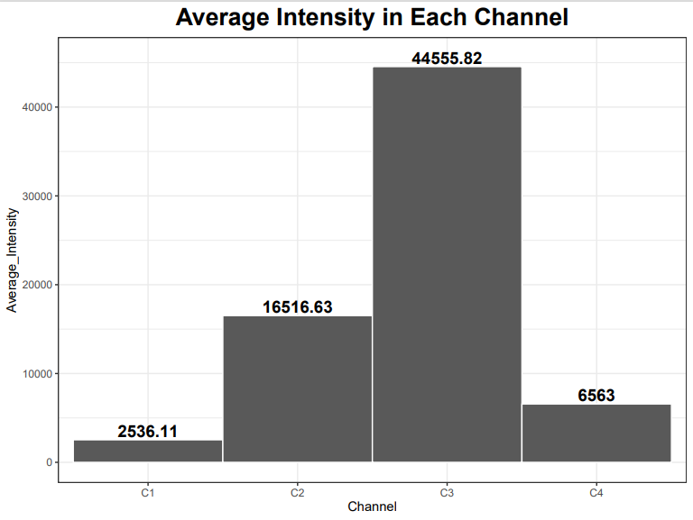
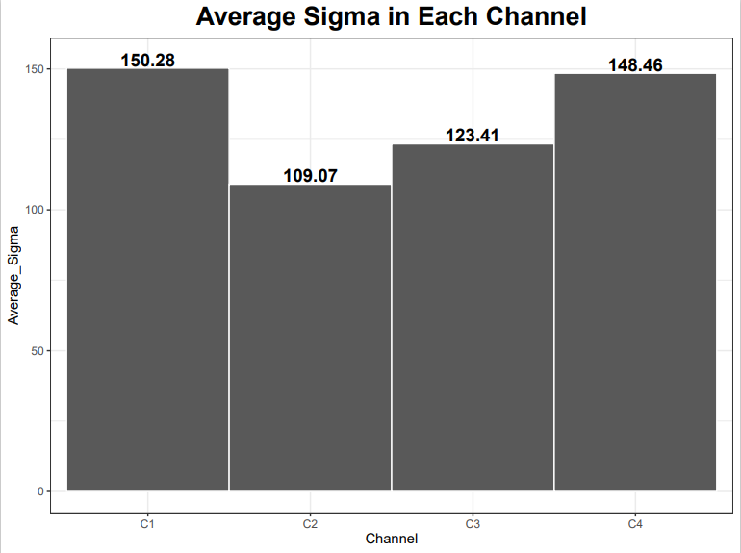
Explore Data – Average sigma/intensity

Slide 5
Explore Data - Distributions
Raw distribution per channel (Showing all spots including zero sigma)
Sigma > 0 per channel (Diff # spots per channel)
Distribution after normalization
Distribution after normalization & Sigma > 0 per channel

Slide 6
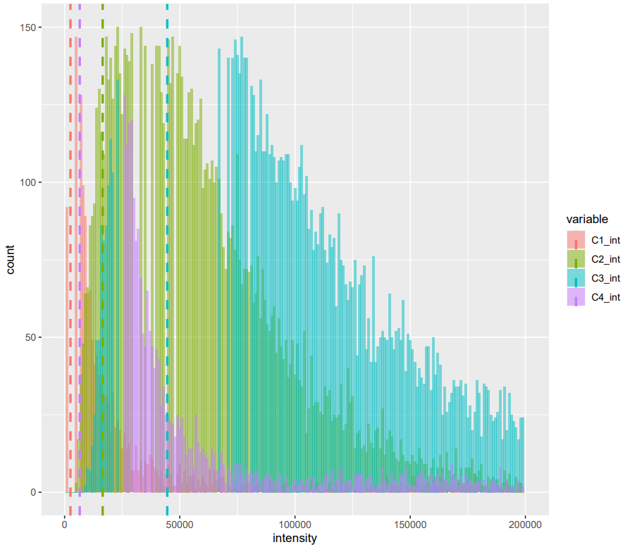
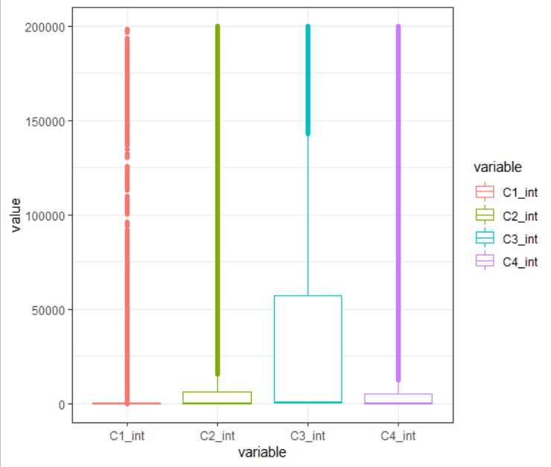
Explore Data – Intensity distribution

Slide 7
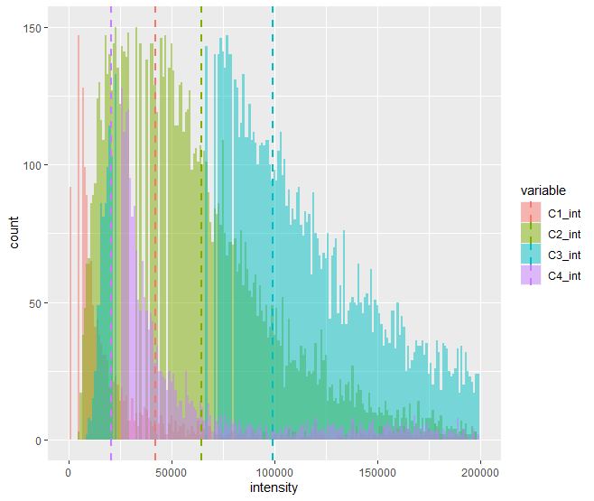
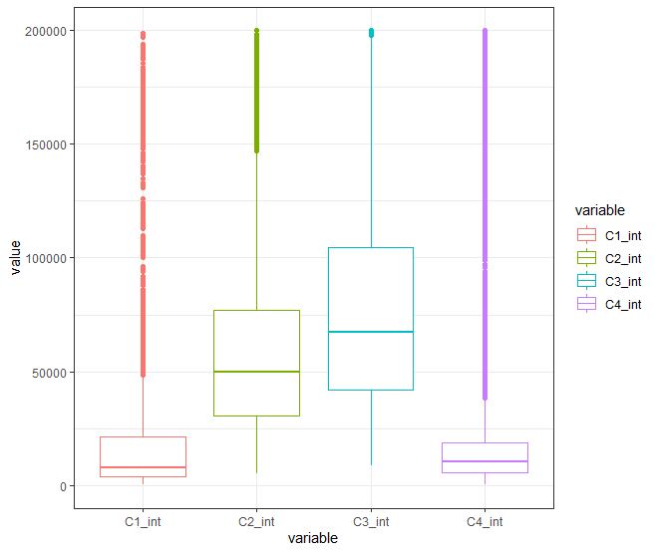
Explore Data – Intensity distribution
Sigma > 0

Slide 8
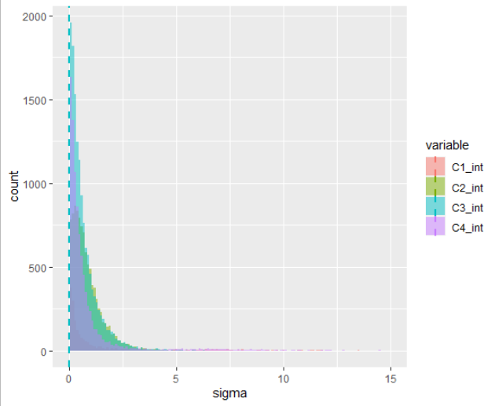
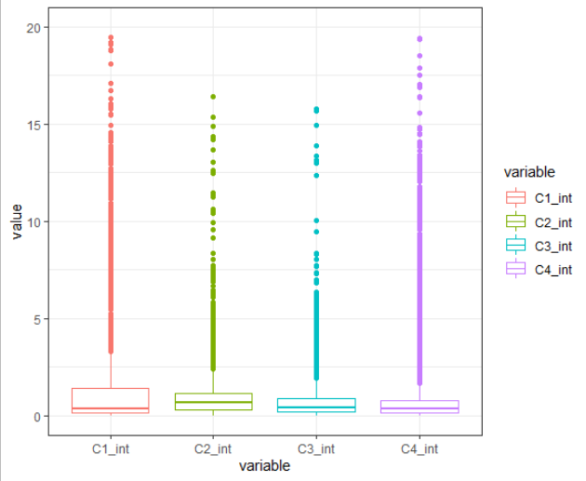
Explore Data – Intensity distribution
After Normalization

Slide 9
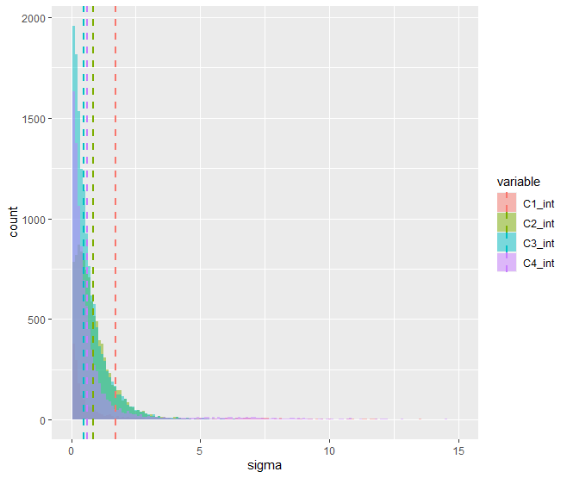
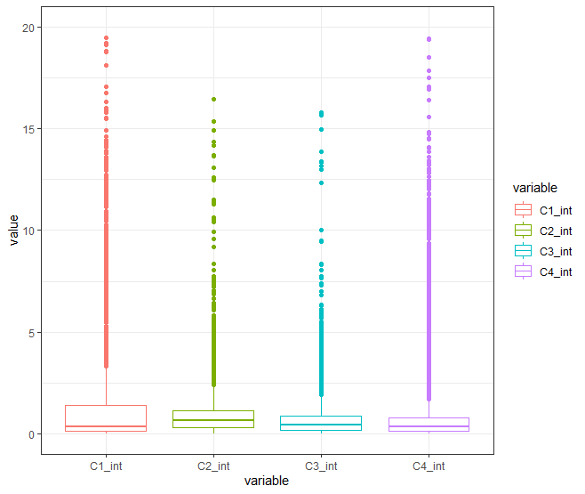
Explore Data – Intensity distribution
After Normalization
Sigma > 0

Slide 10
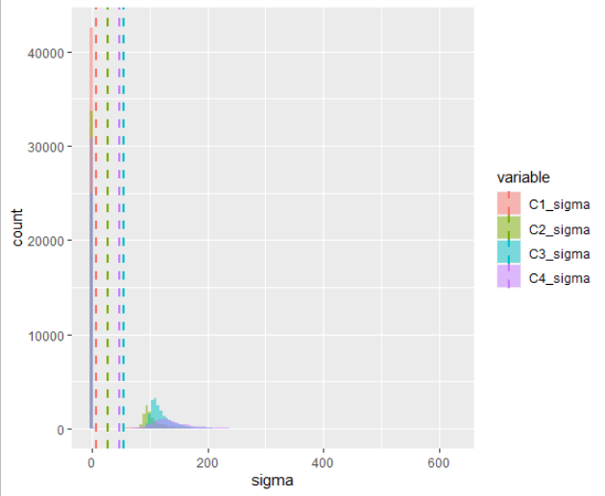
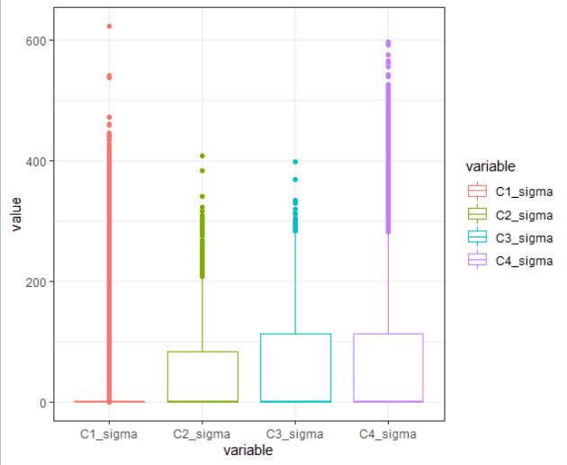
Explore Data – Sigma distribution

Slide 11
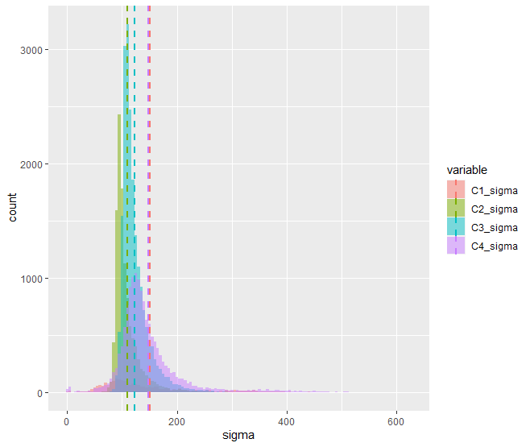
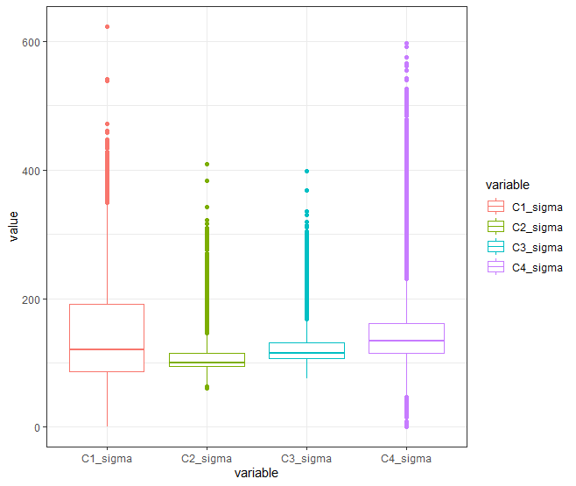
Explore Data – Sigma distribution
Sigma > 0

Slide 12
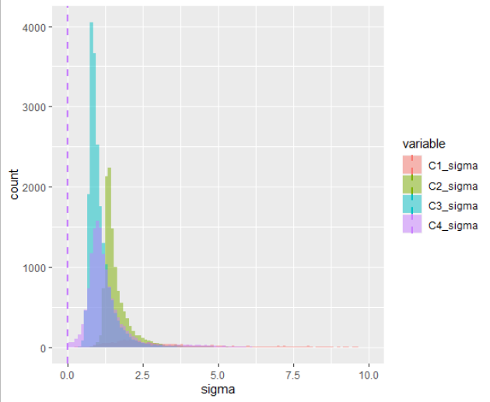
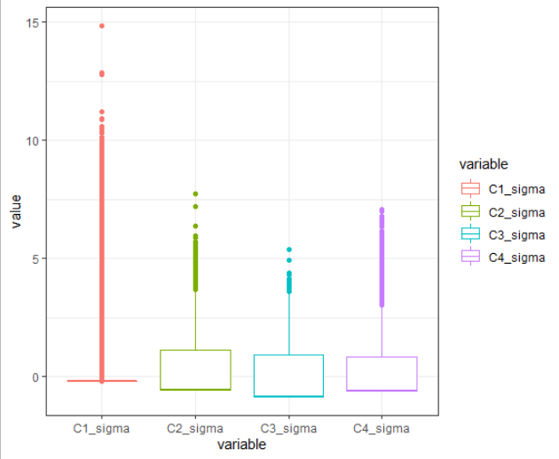
Explore Data – Sigma distribution
After Normalization

Slide 13
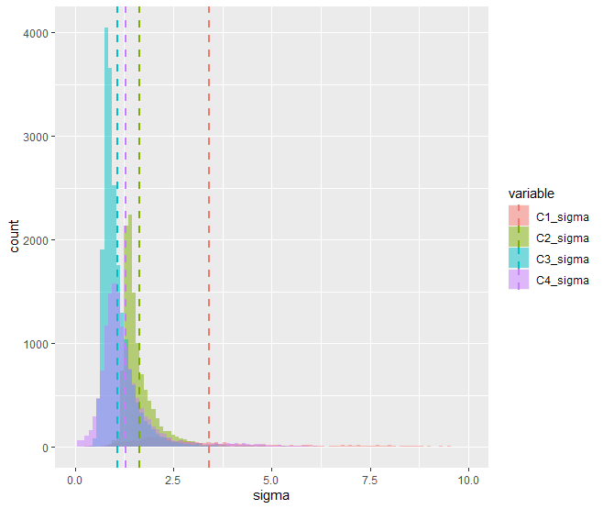
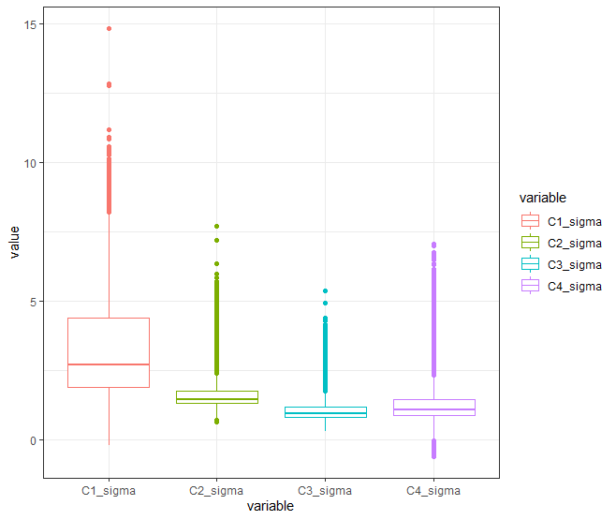
Explore Data – Sigma distribution
After Normalization
Sigma > 0

Slide 14
Cluster Analysis - Model
Normalized data
Euclidean distance
Observation with certain values of features will be clustered together
Correlation based distance methods (e.g. Pearson corr. Spearman corr.) identify clusters of observation regardless of their magnitude
K-means clustering
Most common clustering method

Slide 15
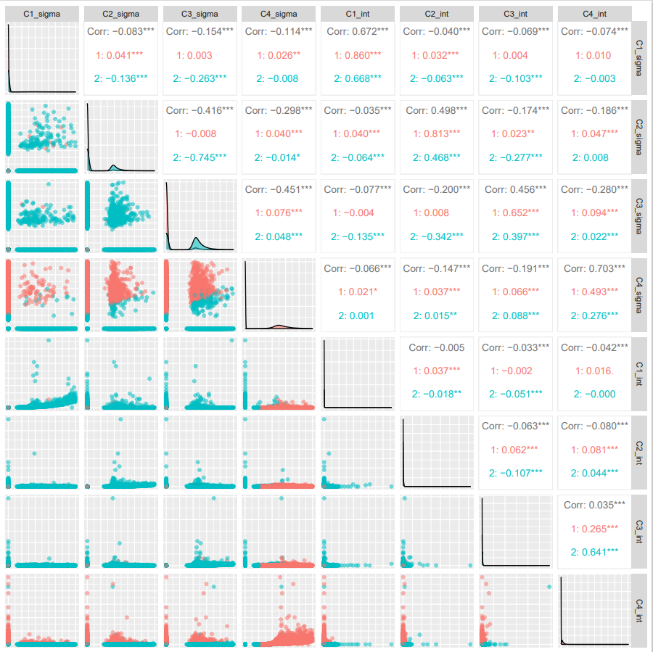
Cluster Analysis (Patient Sample)
Cluster being separated by sigma, not intensity. Especially by C3_sigma.
High proportion of zero values
Intensity almost got no impact on clustering

Slide 16
Cluster Analysis - Model
Normalized data
Euclidean distance
Observation with certain values of features will be clustered together
Correlation based distance methods (e.g. Pearson corr. Spearman corr.) identify clusters of observation regardless of their magnitude
K-means clustering
Most common clustering method
BUT our data contains excessive zeros (zero-inflated data)
In this case, parametric approaches (e.g. Poisson, NB) may lead to a lack of fit. In case of non-parametric approaches, the excessive zeros create a large number of ties.
Cannot assume normal distribution (if normalization : resulting vectors will have very different characteristics than actual data)

Slide 17
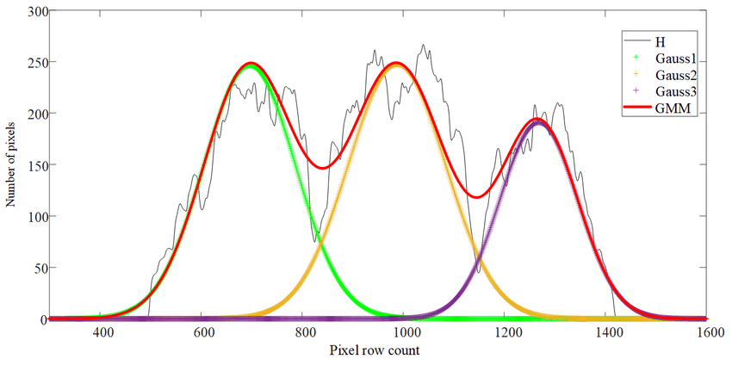

Alternative cluster method?
Sigma는 normal distribution을 가정할 수 없는 상태. 그렇다면 Gaussian mixture model or Two-part model?
R – EMCluster, Python – Scikit-learn
Gaussian distribution이 여러 개 혼합된 clustering 알고리즘
- X가 발생할 확률을 Gaussian probability density function의 합으로 표현
https://untitledtblog.tistory.com/133

Slide 18
Alternative cluster method?
사실 그럼에도 불구하고 sigma 기준으로 cluster 는 됨.. intensity는 나뉘질 않음.
Intensity는 별 변화가 없었으나 sigma는 zero proportion이 높아서 normalization을 적용하였을 때 mean이 굉장히 skewed 됨. -> 원래의 데이터를 잘 반영하지 못함
normal distribution을 가정하고 cluster 했을 때, mean은 상당히 이상해지지만, 0이 아닌 값들의 distribution은 remain. 그냥 이것으로 clustering 강행?

Slide 19
To do
logNorm
안되면 GMM으로 시도
나중에 scikit-learn으로 검증

Slide 20
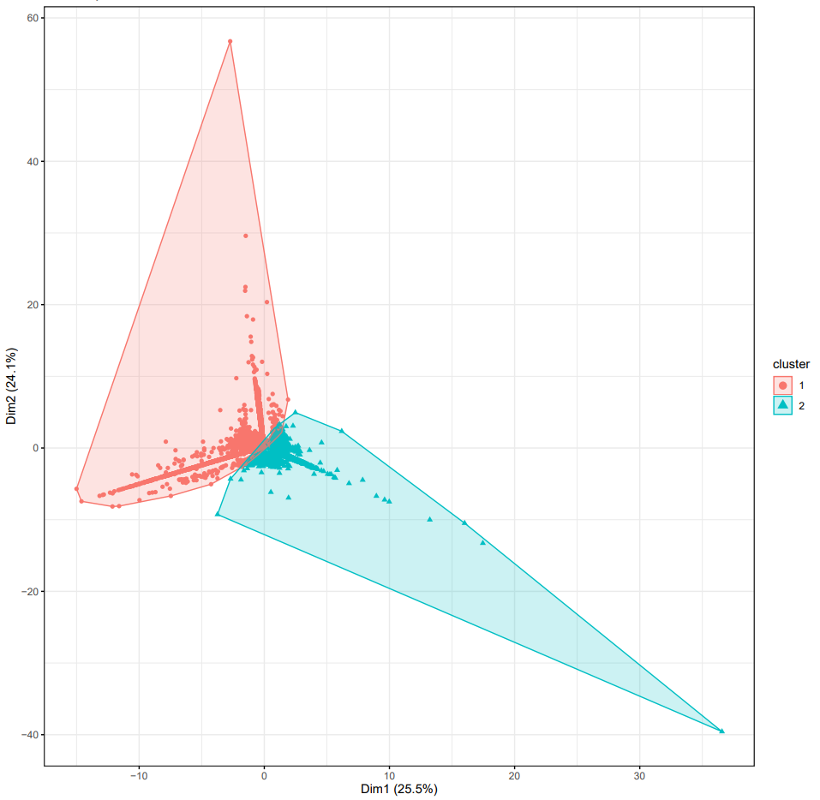
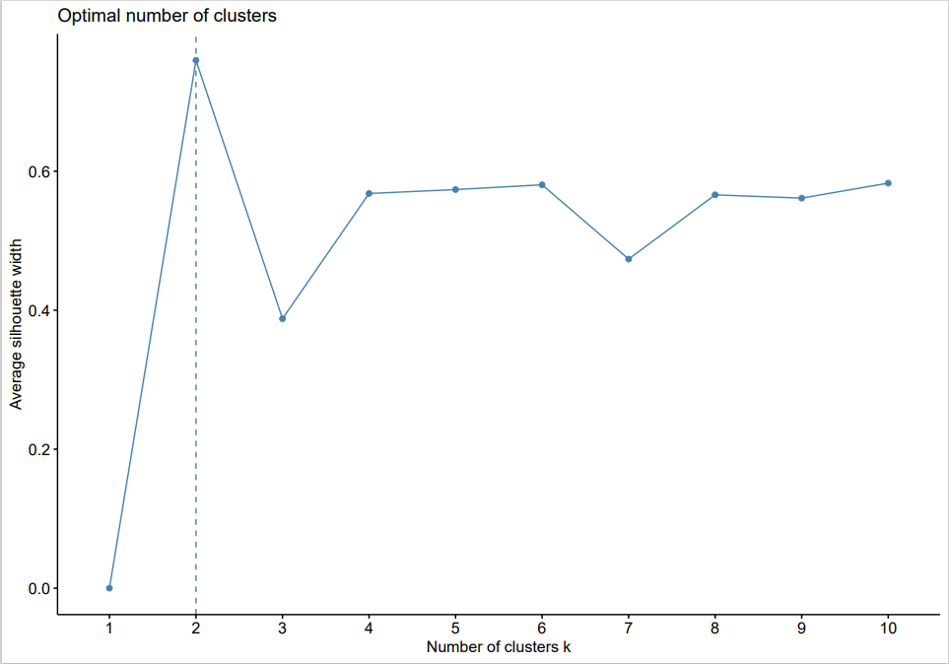
Cluster Analysis (Patient Sample)
Average silhouette coefficient
C1, C2, C4
C3

